Slide 1
Initiate Financial Planning,
Take Control of Your Wealth
Empowering Your Future, Starting Today
Dr. Paris Yeung, CEO of IFPHK
March 2025

Slide 2
Content
Part I – Introduction
Part II – What is Financial planning
Part III – Financial Planning Process
Part IV - How to Teach This to Secondary Students?

Slide 3
About the Speaker
Dr. Paris Yeung, CEO of IFPHK
CEO of the Institute of Financial Planners of Hong Kong
40 years of extensive experience in the banking and finance industry.
Served as the Executive Director and CEO of the Banco Delta Asia Bank (Macau).
Senior management in Hang Seng Bank, Dah Sing Bank, CMB Wing Lung Bank and Chiyu Banking Corporation Ltd.
Served as the General Manager of The Hong Kong Institute of Bankers.
Served as the Lead Consultant of HKPC Academy of the HK Productivity Council
Holds a Doctor of Business Administration (DBA) from The Hong Kong Polytechnic University; MBA, MSc Banking and BA (Accountancy) from The City University of Hong Kong.
Certified Banker of HKIB. CPA of HKICPA. Fellow member of ACCA and HKSI.

Slide 4
Part I
Introduction

Slide 5
Financial issues of today’s youth
Saving
Surveys indicate young people (aged 15-24) struggle to save consistently, with many lacking formal saving strategies or emergency funds.⁽¹⁾
Financial Management
About 40% of youth aged 15-24 have experienced money management difficulties, including budgeting, saving, investing, and debt handling. ⁽¹⁾
Investment
Nearly half of young people feel unsure about how to start investing or choose suitable products. ⁽²⁾
Many find investment entry thresholds too high, and financial literacy (particularly for digital finance) lags behind adults. ⁽²⁾ ⁽²⁾
https://cps.hkfyg.org.hk/2025/06/23/yhk_17_2_interview_the-irreplaceable-value-of-financial-wisdom/
https://www.hangseng.com/cms/ccd/eng/PDF/171024e.pdf
https://www.ifec.org.hk/web/common/pdf/about-ifec/financial-literacy-monitor-2024.pdf

Slide 6
Financial issues of today’s youth
Debt
Credit Card Penetration: 70% of young adults aged 21–25 have a credit card, compared to industry averages.^{[1]}
Personal Loans: 5% of 21–25 year olds hold a personal loan, increasing to 11% in the 26–30 age group.^{[1]}
Delinquency: Credit card delinquency at 30+ days past due is 1.5% for 21-year-old prime cardholders (lower for older cohorts).
Financial Literacy
Average financial management ability score for students: 12.7 out of 21, indicating "room for improvement" in budgeting and saving skills.^{[2]}
Knowledge Score: Average knowledge score is 31.6 out of 35 for students and young adults (high relative to regional benchmarks).^{[3]}
Attitude and Behavior: Financial attitude scores (10.7/20) and behavior scores (28.6/45) are lower, suggesting weaker habits in long-term planning and budgeting.^{[3]}
Introducing financial planning is the key.
https://newsroom.transunion.hk/young-adults-offer-significant-potential-for-growth-for-hong-kongs-credit-market--transunion-study/
https://www.ifec.org.hk/web/common/pdf/about-ifec/financial-literacy-monitor-2024.pdf
https://www.hkma.gov.hk/eng/news-and-media/press-releases/2024/05/20240516-4/

Slide 7
Part II
What is Financial Planning?

Slide 8
Definition of Financial Planning
The Financial Planning Standards Board (FPSB) defines financial planning as a collaborative, iterative process that involves assessing a client’s financial situation and developing strategies to achieve their life goals, such as buying a home, saving for education, or planning for retirement.

Slide 9
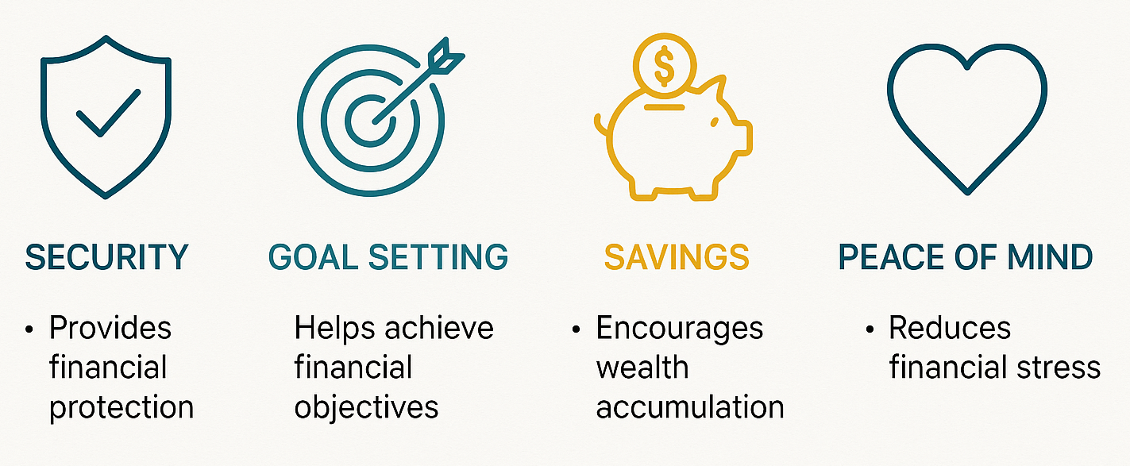
Why is it Important?

Slide 10
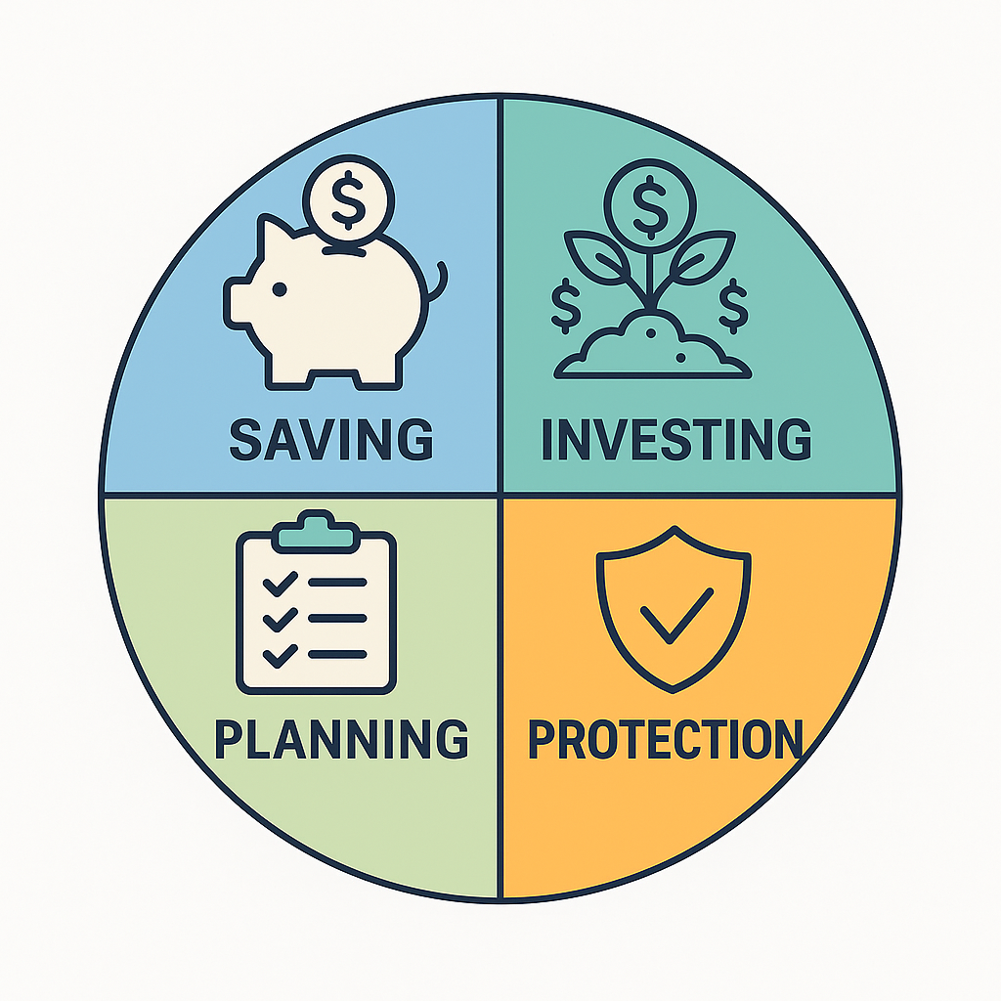
The Core Elements of Financial Planning
Saving (Emergency fund)
Investing (Wealth growth)
Protection (Insurance & risk management)
Planning (Goals & budgeting)

Slide 11
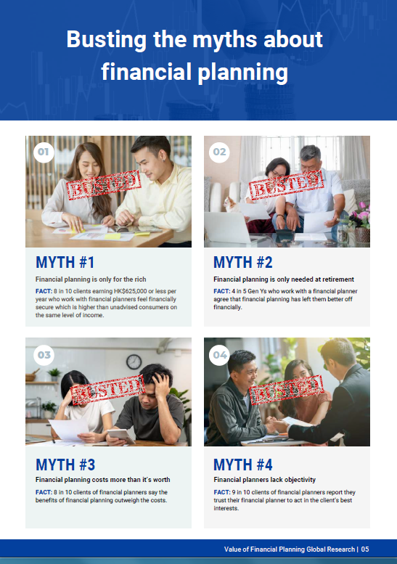
Common Misconceptions
"Financial planning = only for the rich" → Actually, it's for everyone.
"It's too early to start now" → The power of compound interest (Example: difference starting at age 25 vs. age 45).
(source: Value of Financial Planning – Global Consumer Research, Finding of IFPHK, 2023)

Slide 12
Change Review on Retirement – Micro-retirement
HSBC Quality of Life Report 2025
47% of affluent HK investors consider planned breaks (“micro-retirement”) before full retirement.
46% plan 2–3 such breaks; first ideally at age 49.
40% would spend up to HK$785,000 each time.
Top motivations:
• Quality time with family (34%)
• Travel & exploration (31%)
• Personal health & wellbeing (30%)
Funding sources: dividends, interest & capital gains (51%); personal savings (42%).
Popular destinations: Mainland China (37%), Japan (23%), Taiwan (22%).
Takeaway: Retirement planning today can mean financing multiple planned breaks
—start early to build flexibility

Slide 13
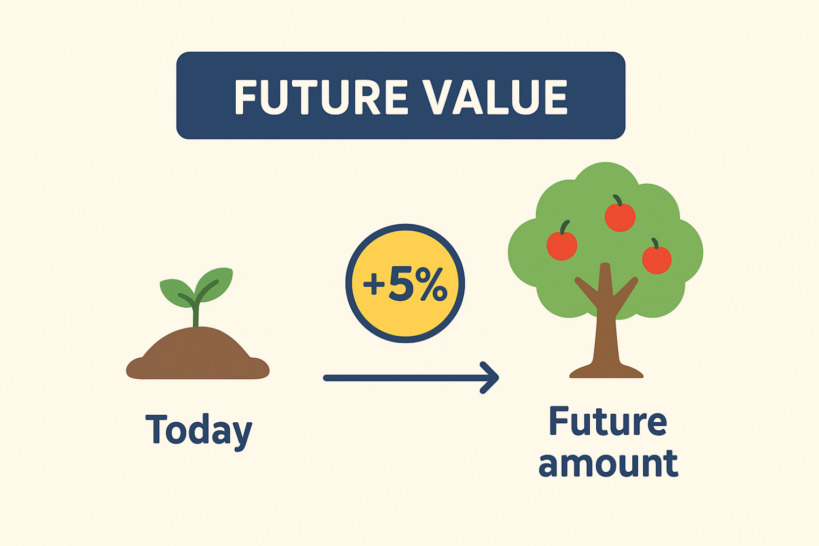
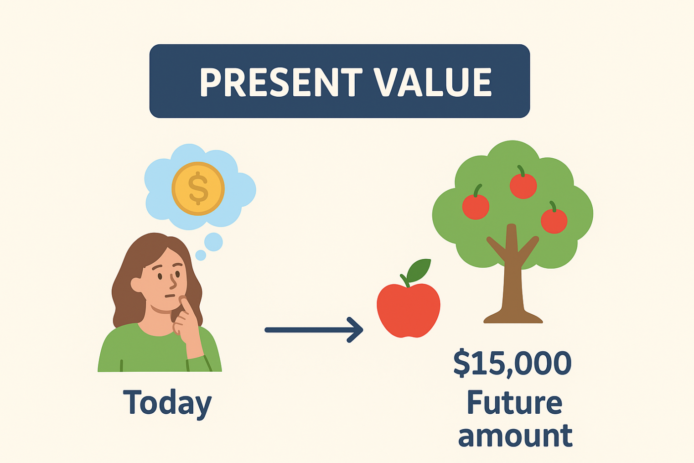
Time is Money
Future Value (FV) – Money Grows Like a Seed
Present Value (PV) – From Fruit Back to Seed
Start: $15,000 (seed)
Planted: in savings (soil) with 5% interest (sunlight & water)
After 1 year: Tree with fruit = $15,750
Future fruit: $15,000 in 1 year
Ask: What seed today grows into $15,000?
Answer: $14,286 today (with 5% growth)

Slide 14
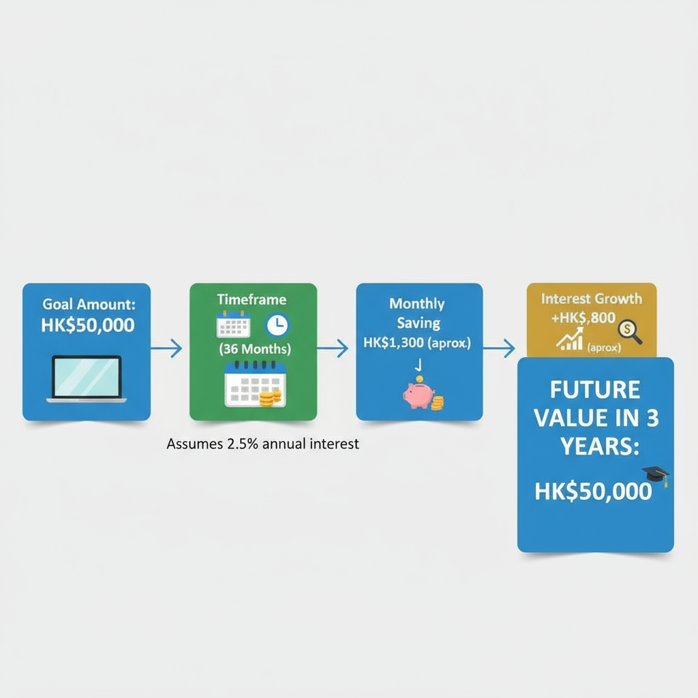
How Do These Concepts Affect Financial Planning?
Situation 1: Saving for a Goal (Using Future Value)
- Dream: You want to buy a $50,000 laptop for university (let's say in 3 years).
Financial Planning:
You can't start saving $50,000 in 3 years.
You need to ask: "How much do I need to save each month starting now (and earn interest) so that the Future Value in 3 years will be exactly $50,000?"
The Impact: This makes you start saving early and look for savings accounts that pay interest to help your money grow, instead of just hiding cash in a piggy bank.

Slide 15
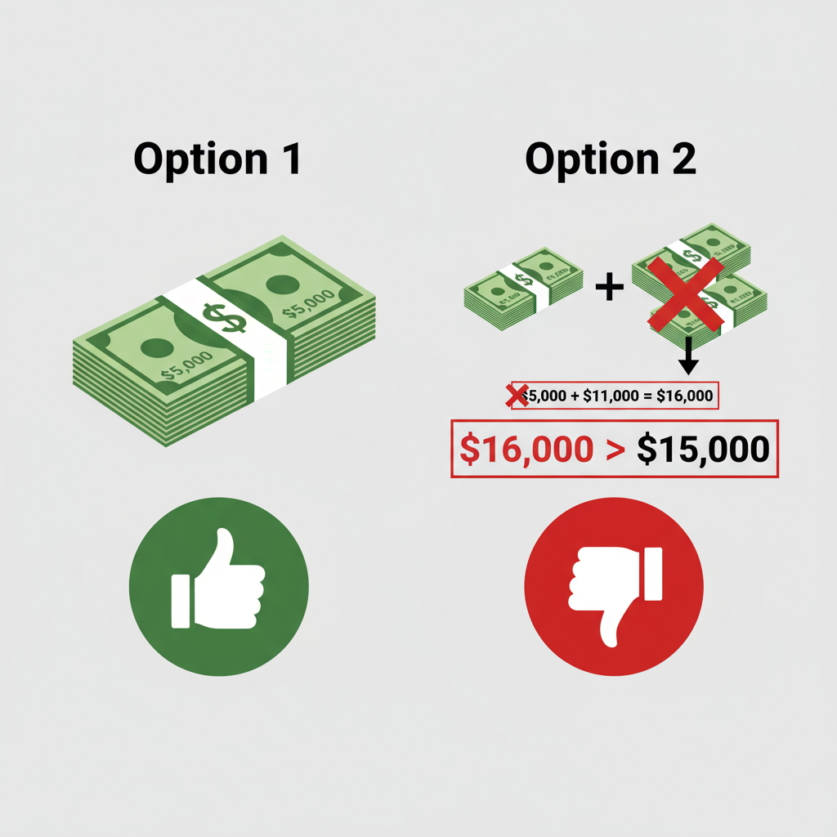
How Do These Concepts Affect Financial Planning?
Situation 2: Spending Choices (Using Present Value)
The Choice:
1. Pay $15,000 in full for the console today.
2. Use an installment plan: Pay $5,000 now and $11,000 one year later.
Which is a better deal?
Financial Planning: You can't just compare 15,000 and (5,000+11,000)=16,000.
You must convert the "future $11,000" into its Present Value. Assuming a 5% interest rate, the Present Value of $11,000 in one year is about $10,476.
The total Present Value cost of option 2 = $5,000 (today) + $10,476 = $15,476.
Comparison: Option 1 (PV = $15,000) < Option 2 (PV = $15,476)
Conclusion: Paying in full today is actually cheaper! The installment plan has hidden interest costs.

Slide 16
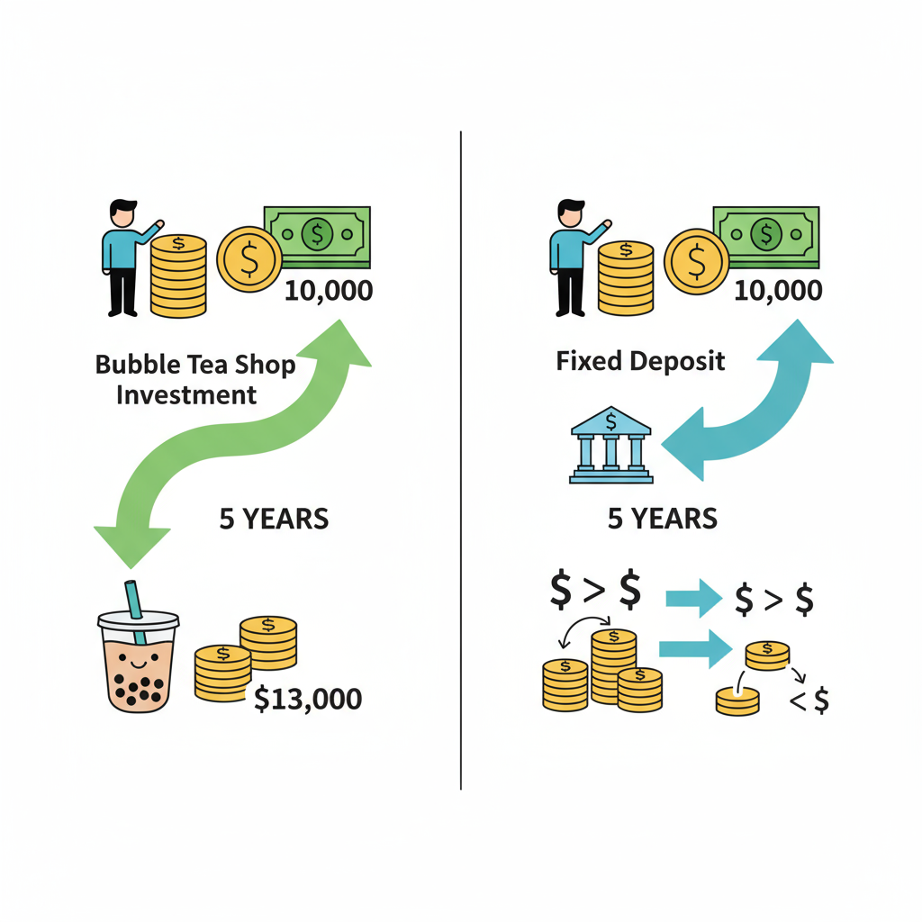
How Do These Concepts Affect Financial Planning?
Situation 3: Investment Decisions
Opportunity: A friend asks you to invest $10,000 in a bubble tea shop, promising to pay you back $13,000 in 5 years.
Financial Planning: You can't just see that $10,000 turns into $13,000, a $3,000 profit.
You must ask: "What is the Present Value of that future $13,000? Is it higher than my $10,000 today?
Or would the Future Value of my $10,000 in a bank fixed deposit (e.g., at 2% interest) be higher?“
Only after this comparison can you decide if it's a good investment

Slide 17
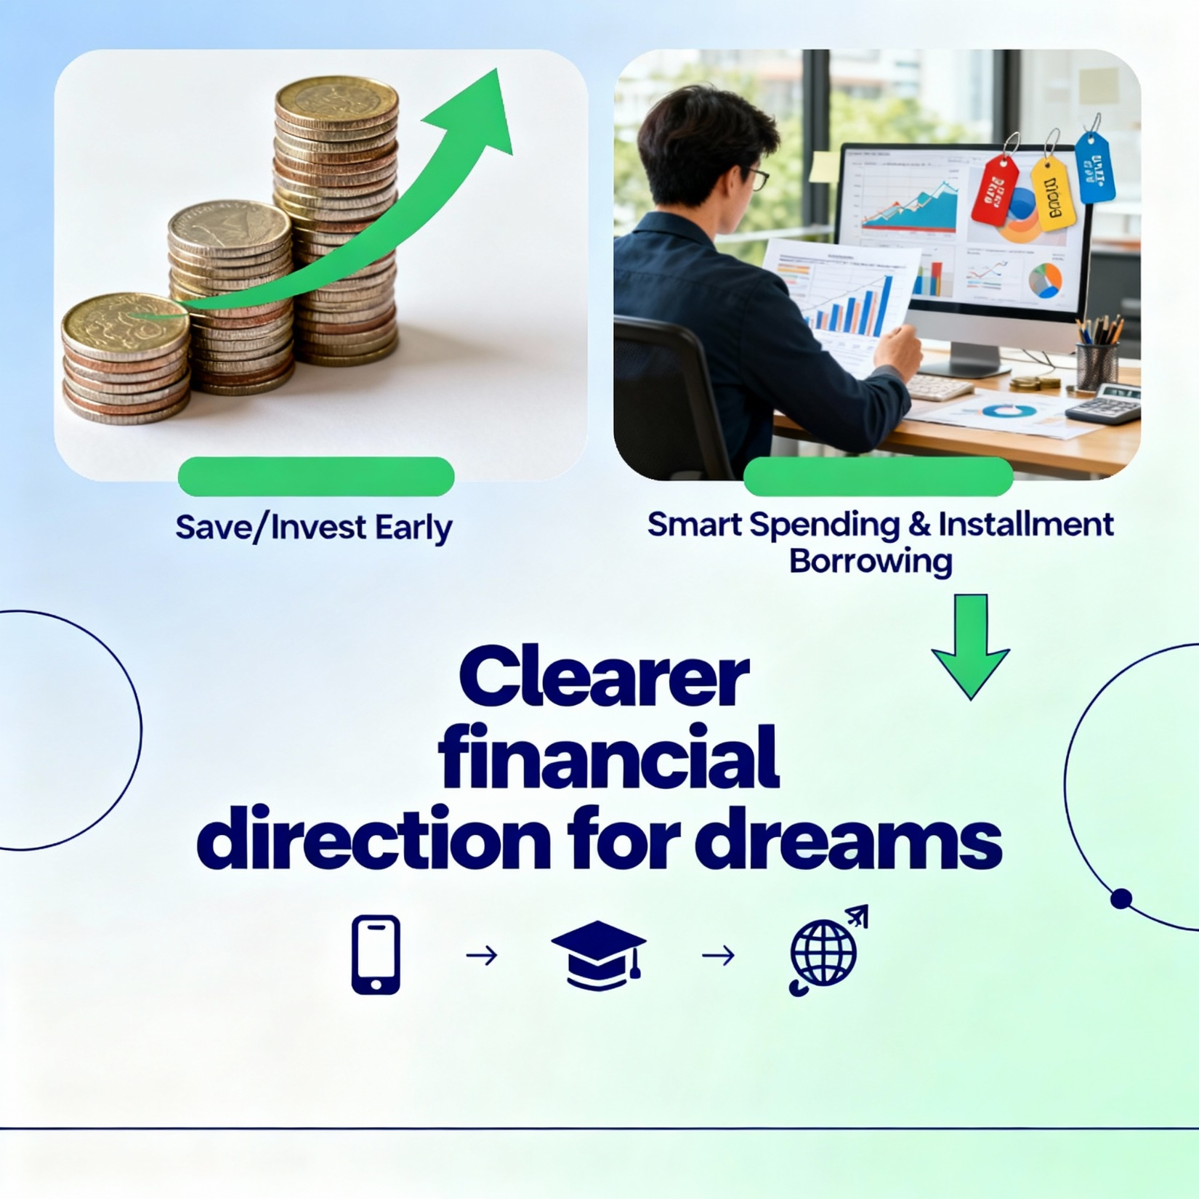
Key Takeaways
Future Value: Encourages you to start saving and investing early. Let time be your best friend, helping your small money grow into big money.
2. Present Value: Helps you spend and borrow smartly. It allows you to see the true cost and value behind "installment plans" and "future returns," so you don't get tricked by numbers.
Learning these two tools will put you a step ahead in planning your financial future. Whether you're saving for a phone, university, or a bigger dream, you'll have a much better sense of direction

Slide 18
Part III
Financial Planning Process

Slide 19
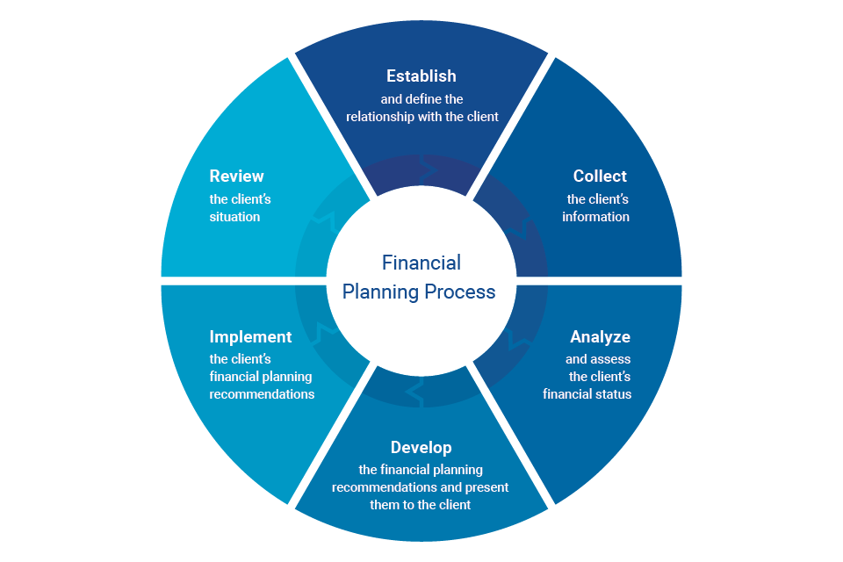
Financial Planning Process
FPSB’s Financial Planning Process is a collaborative, iterative approach that financial planning professionals use to consider all aspects of a client’s financial situation when formulating financial planning strategies and making recommendations. The process is arranged into six elements:

Slide 20
Part IV
How to Teach This to Secondary Students?

Slide 21
How to apply financial planning process on personal finance
Step | FPSB Process (Summary) | Application (example)
1. Establish and Define the Relationship | Explain process, services, competencies; disclose conflicts; agree on scope/terms in writing. | Decide how you’ll manage your money (e.g., “I’ll plan my HK$500 monthly allowance”). Be honest about biases (e.g., “I love spending on games”). Write down your focus, like saving for a concert ticket, in a notebook or app.
2. Collect Information | Identify goals; gather quantitative (e.g., income) and qualitative (e.g., values) data | List your goals (e.g., buy a HK$1,000 phone in 6 months). Track income (e.g., allowance, red packet money) and expenses (e.g., snacks, transport) for a week
3. Analyze and Assess Financial Status | Assess current situation vs. goals; identify resources, risks, constraints. | Compare income to spending (e.g., “I spend HK$300/month but need to save HK$200”). Note risks like impulse buys or emergencies (e.g., phone repair). Check if goals are realistic.
4. Develop and Present Recommendations | Develop strategies; present recommendations with rationale; adjust based on feedback | Brainstorm ideas (e.g., cut bubble tea to save HK$100/month or sell old clothes). List pros/cons (e.g., “Saving takes longer but avoids debt”). Choose a plan and note why. Plan to revisit if prices rise.
5. Implement Recommendations | Agree on actions; identify tools/services; assign responsibilities. | Act on your plan (e.g., set aside HK$50/week in a jar or free budgeting app like Money Lover). Stick to it yourself. Avoid paid services—keep it simple and free.
6. Review the Situation | Set review terms; update based on personal/economic changes. | Check progress monthly (e.g., “Saved HK$600 for the phone yet?”). Adjust for changes like lower allowance or new goals (e.g., school trip). Stay flexible.

Slide 22
Role of Teacher in financial planning for youth
Context: Explain that teens manage small but meaningful finances (e.g., allowances, part-time job earnings). The FPSB process, though professional, is adaptable for teaching discipline and goal-setting.
Practicality: Emphasize simple tools (e.g., notebooks, free apps) to avoid overwhelming students. Use relatable examples like saving for a gadget or outing.
Empowerment: Highlight that this process fosters independence. Teens learn to analyze, decide, and adapt—skills for life.
Engagement: Integrate into life skills classes, using group activities (e.g., mock budgeting) to make it fun.
"Teaching kids about money is a gift for life.”
– never too early

Slide 23
Summary
Financial Planning is an ongoing process; starting early is easier.
Core: Goals Plan Implement Review
A systematic process of managing financial resources to achieve goals
And avoid financial crises.
Develop students’ responsibility, independence and skills.
Enhance financial literacy and reduces social issues.

